Slide 1
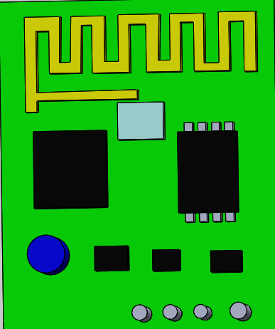
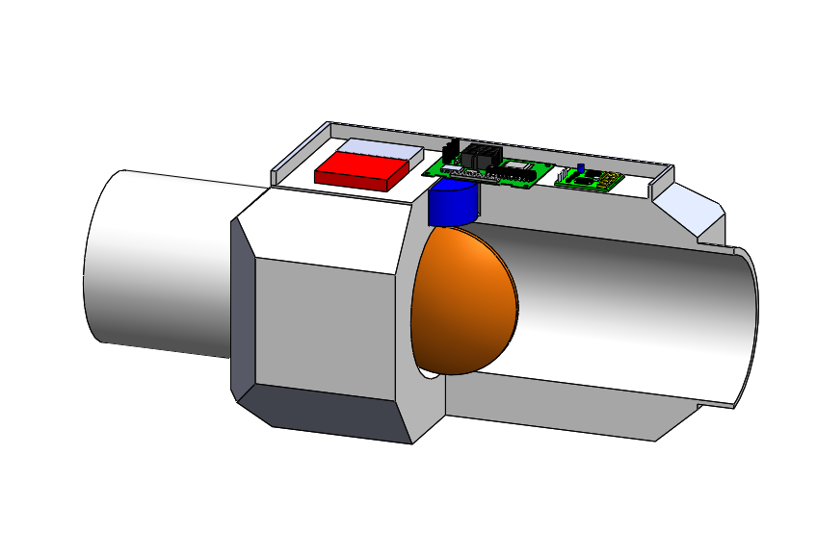
2
1
65 Cm
4
25 Cm
46 Cm
120 Cm

Slide 3
3
2
65 Cm
1
25 Cm
46 Cm
4
120 Cm

Slide 5
